Slide 1
New Tenant Onboarding
STRONGHOLD

Slide 2
Support
ccv.brown.edu→ Documentation → Stronghold
    https://docs.ccv.brown.edu/stronghold/
support@ccv.brown.edu

Slide 3
Agenda
Overview
Key Security Groups
Login Process
Software
Transfer Server
Questions?

Slide 4
Overview
“Tenant” - self contained, highly secure storage and compute environment
Accessible from Brown compliant network and VPN
Shared responsibility model
  Office of Information Technology (OIT) is responsible for technology and Security
  OIT will NOT access your data
  PI is responsible for Data Management and ensure users are trained to handle sensitive data
    PI is responsible for requesting and approving access to the tenant, data security groups & billing
Encrypted or unencrypted storage available (determined by DUA)
Notes:
If URSA add
URSA is responsible for onboarding all users (ensures users are trained to handle sensitive data)

Slide 5

Key Security Groups
Admins (PI is only member by default)
    Exclusive access to data directory
      Subfolders need to be created and security groups assigned in order for other team members to have access
      Users will NOT be able to access data until folders are created
  Security Groups Available by Default
  Users – can include all team members
  Staff – can include a subset of team
Security Groups that Can be Requested
  Create a custom group for a particular project – can include members of that project
Member of Admins team will assign above security groups to newly created folders to restrict data access
  This way PI has complete control over who has access to what data
Notes:
Emphasize: 1.3 – The PI has to create the Project folder. Only PI can write to the ROOT directory.
Transition:
Why we do this?
Use Mete’s example - the wild-wild-west example.
Now when you create these folders – you assign the permissions, gives you granular control over the permissions. You know who can get to it.
We give you other groups.
Nested groups.
These security don’t mean anything, unless they have to be assigned to the a folder so you can restrict who has access ti it.
Transition:
Looks at three project directories.
TODO:
Add bullet – Adding anyone to a security group requires PI approval.

Slide 6
Key Security Groups
Other responsibilities of Admins Group
    Only member is PI (or approved delegate)
    By default, member of all other groups
    Explicit approval required by PI for group membership
      We will ask you which specific groups to add users to
Security groups for data transfers - “keys to the kingdom”
Import_W & Import_R - data into Stronghold
Export_W & Export_R - data out of Stronghold

Slide 7
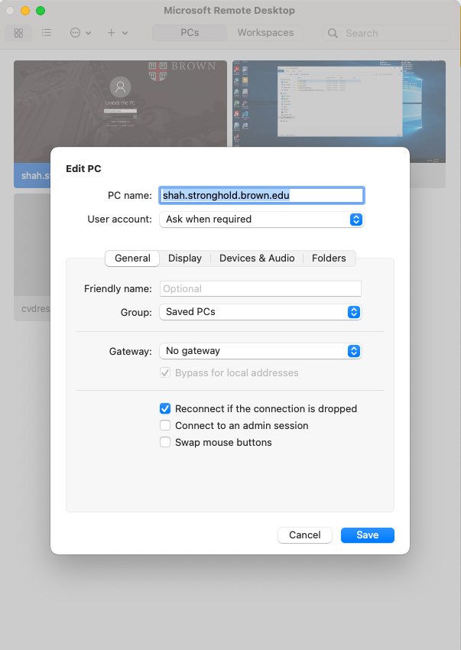
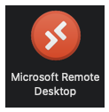
Login
                Microsoft Remote Desktop Needed
                Ursa.stronghold.brown.edu:3396
                Windows – Pre-installed
                Mac / Linux – Download from software.brown.edu
                https://www.brown.edu/information-technology/software/catalog/microsoft-remote-desktop
                Hostname – <tenant>.stronghold.brown.edu

Slide 8
Software
Majority of Software stack is pre-installed
    MATLAB
    R
    Office Suite
    Stata
    Office Suite
    VS-Code
    Arc GIS
Python (pip) and R (cran) repository
  Launch Rstudio GUI
  Matlab GUI

Slide 9
Transfer Server
Utilized for all data movement in and out of Stronghold
SFTP, FTPS, HTTPS protocols available for data transfers
Real time alert sent to <tenant>_admins group for each executed transfer
Each step of transfer process requires membership in different Active Directory security group, so granular control of who can execute which step

Slide 10
More Support
Folder Creation and Security Assignments
  CCV staff can do this upon request from PI
  CCV staff will document
    Temporarily adding themselves to Admins group
    Creating folder and assigning security group
    Removing themselves from Admins group so they no longer have access to the data
Data Transfers
  CCV staff can assist PI execute data transfers over interactive zoom conference

Slide 11
Questions
support@ccv.brown.edu

